Slide 1
Predicting Genetic Variants that are Conflicting Classified
Gurdeep Sullan
Springboard Data Science Career Track
Capstone Project I
03/11/2020

Slide 2
Genetic Testing - Background
Reasons for genetic testing:
Pre-emptive screening for inherited diseases
Diagnosis confirmation
Patient samples are sent to one or more labs to test for specific variants
The result is scored on a 5-level scale as shown below:
Results guide treatment and healthcare planning

Slide 3
Problem Statement
A large problem in genetic testing is that some mutations are consistently classified, while other mutations receive conflicting classifications when tested at different laboratories.
What makes a genetic variant more prone to be conflictingly classified versus consistently classified? Given the features of a variant, can we predict if it will be conflictingly classified?

Slide 4
Data
Kaggle competition dataset (https://www.kaggle.com/kevinarvai/clinvar-conflicting)
Originally from ClinVar database (https://www.ncbi.nlm.nih.gov/clinvar/)

Slide 5
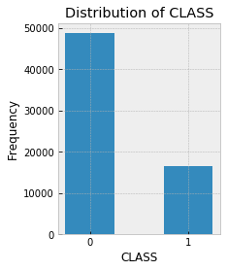
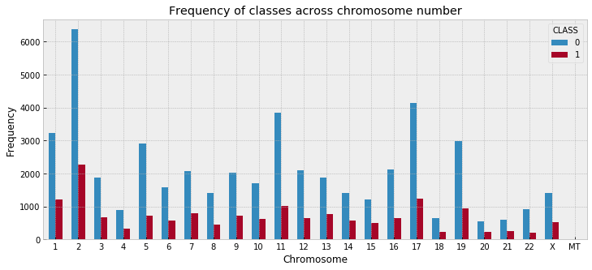
Exploratory Data Analysis
65,188 entries, 61 numerical features

Slide 6
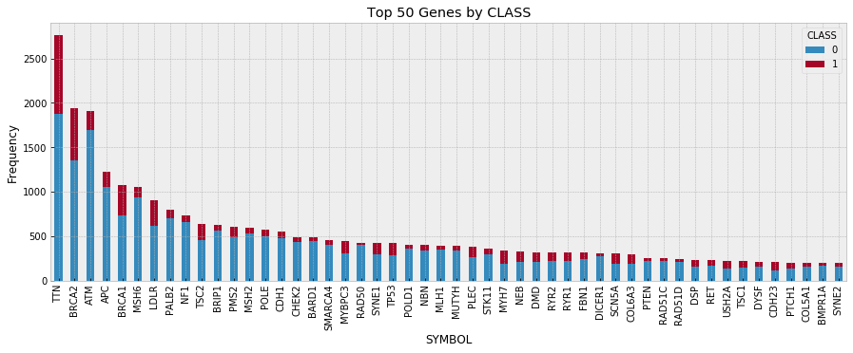
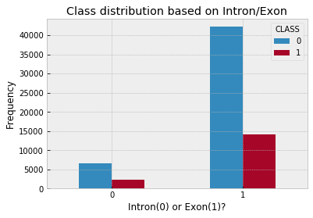
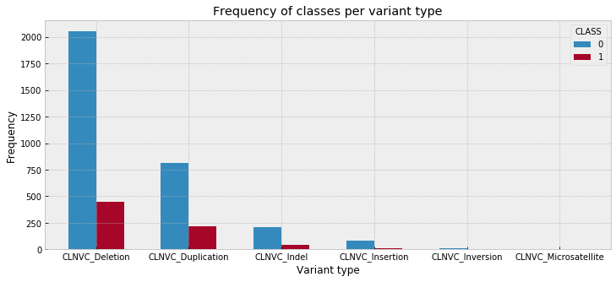
Exploratory Data Analysis

Slide 7
Machine Learning Models
Binary classification problem
Four classifiers chosen:
Logistic Regression
Decision Tree Classifier
Random Forest Classifier
XGBoost Classifier

Slide 8
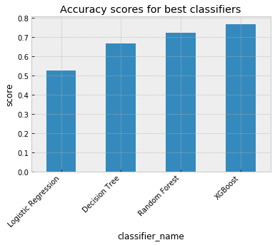
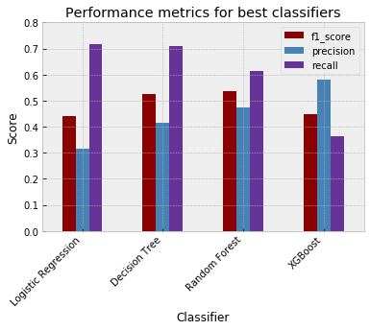
Model Comparison and Evaluation
Classifier | test accuracy | train accuracy | precision | recall | f1 score
Logistic Regression | 0.53 | 0.54 | 0.32 | 0.72 | 0.44
Decision Tree | 0.67 | 0.69 | 0.42 | 0.71 | 0.52
Random Forest | 0.73 | 0.83 | 0.47 | 0.61 | 0.53
XGBoost | 0.77 | 0.93 | 0.58 | 0.36 | 0.45

Slide 9
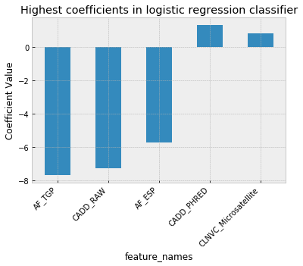
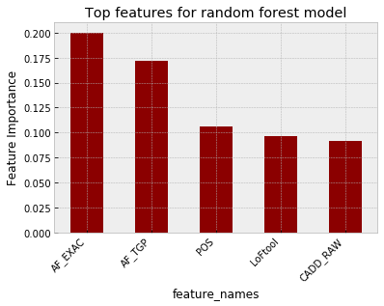
Coefficients and Feature Importances
Notes:
Note: not a 1:1 comparison

Slide 10
Conclusions
Evaluate models on the f1 score, and not just the test accuracy, due to class imbalance in our dataset
The best performing model is Random Forest Classifier
Allele frequency seems to be an important feature in both Logistic Regression and Random Forest models
In silico predictors are important features in these models - transfer learning

Slide 11
Future Directions and Recommendations
Additional NLP on the categorical features that couldn’t be used
Disease identifier
Variant Consequence
NLP using SentencePiece on raw genome data at genetic loci of variants for information on co-occurring variants, and effects of other variants

Slide 12
Acknowledgments
Springboard
Hobson Lane
Data
ClinVar
Kaggle

